Slide 1


<Name>
<Date>

Slide 2

Outline
Executive Summary
Introduction
Methodology
Results
Conclusion
Appendix

Slide 3
Executive Summary
Summary of methodologies
The aim of the project is to find out the factors and success rate for a successful landing of the first stage of the rocket. To make this possible following methodologies were used.
Data Collection: SpaceX launch historical data was collected from SpaceX API and Wikipedia through web scraping
Data Cleaning and Exploration: The collected data was cleaned and prepared for analysis using Python, and SQL was used for exploration.
Data Visualization: Python libraries like pandas and seaborn were used to create visualizations to identify patterns. A geographical chart was generated to analyze data, and an interactive dashboard was created.
Model Building: Relevant factors influencing rocket landing success were identified, and a machine learning model was developed to predict future outcomes.
Results
Exploratory data analysis:
Success rate improves over the years
KSC LC-39A has the highest success rate among landing sites
Orbits ES -L1, GEO, HEO, and SSO have a 100% success rate
Visualization/Analytics:
• Most launch sites are near the equator, and all are close to the coast
Predictive Analytics:
• All models performed similarly on the test set. The decision tree model slightly outperformed

Slide 4
Introduction
Project background and context
SpaceX, a prominent player in the space industry, aspires to democratize space travel by making it more affordable for everyone. The company has achieved remarkable milestones such as sending spacecraft to the international space station, deploying a satellite constellation for global internet access, and conducting crewed missions to space. SpaceX can achieve these feats thanks to its cost-effective rocket launches, priced at approximately $62 million per launch, primarily due to the innovative practice of reusing the first stage of its Falcon 9 rocket. In contrast, other providers, lacking the capability to reuse the first stage, incur costs exceeding $165 million for each launch. By assessing the successful landing of the first stage, we can determine the launch cost. To achieve this, we can leverage publicly available data and employ machine learning models to predict whether SpaceX or a competing company can successfully recover and reuse the first stage.
To find
How payload mass, launch site, number of flights, and orbits affect first-stage landing success
Rate of successful landings over time
Best predictive model for successful landing (binary classification)

Slide 5

Section 1

Slide 6
Methodology
Executive Summary
Data collection methodology:
Using API calls and web scrapping from Wikipedia.
Perform data wrangling
Data formatting, removing nulls etc.
Perform exploratory data analysis (EDA) using visualization and SQL
Perform interactive visual analytics using Folium and Plotly Dash
Perform predictive analysis using classification models
Testing between 4 different machine models to choose the optimal choice.

Slide 7
Data Collection
The Data for analysis is sourced using two methods:
API CALL: Using the SpaceX API to get data regarding the rocket
Web scrapping: scrapping data from Wikipedia regarding the other aspects of the launch
Both the data from these sources will joined to together to form a more meaningful data that would be used for the analysis

Slide 8
Data Collection – SpaceX API
Steps
Request data from SpaceX API (rocket launch data)
Decode response using .Json() and convert to a dataframe using .Json normalize()
Request information about the launches from SpaceX API using custom functions
Create dictionary from the data
Create dataframe from the dictionary
Filter dataframe to contain only Falcon 9 launches
Replace missing values of Payload Mass with calculated .mean()
Export data to csv file
Here is the github link to the code base: https://github.com/Giga1025/IBM_Data_Science_capstone/blob/main/Data_collection_api.ipynb
Place your flowchart of SpaceX API calls here

Slide 9
Data Collection - Scraping
Steps
Request data (Falcon 9 launch data) from Wikipedia
Create BeautifulSoup object from HTML response
Extract column names from HTML table header
Collect data from parsing HTML tables
Create dictionary from the data
Create data frame from the dictionary
Export data to csv file
The github link to the code base: https://github.com/Giga1025/IBM_Data_Science_capstone/blob/main/Data_collection_webscrapping.ipynb
Place your flowchart of web scraping here

Slide 10
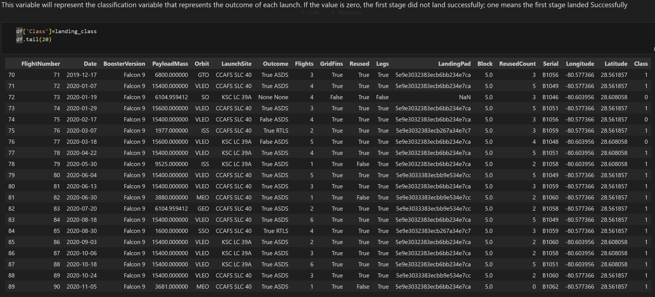
Data Wrangling
With already a little cleaned data, here we learned information regarding the data categories like launch sites, orbits etc.
We formatted the data column that had success and failure status, for machine learning model purpose we convert the data in that column to 0’s and 1’s. 0 shows the success and 1’s show the failure
The resulting dataframe is checked for any errors and exported to a csv document.
The link to the github code base: https://github.com/Giga1025/IBM_Data_Science_capstone/blob/main/Data_wrangling.ipynb

Slide 11
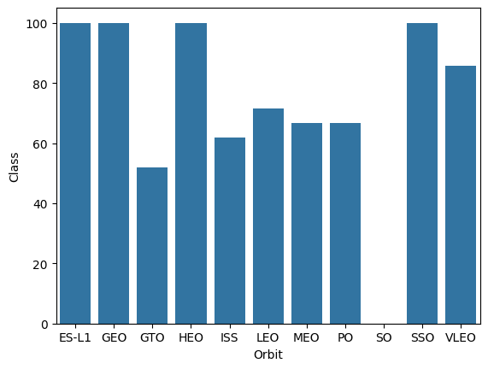

EDA with Data Visualization
There are 3 types of charts that were used in this stage:
Scatter plot: These charts are used to find the relationships between Orbits, Flight numbers, payloads and class
Line plot: This plot is used for finding the success rate of rockets over the years
Bar plot: This plot is used find the success rate of orbits.
The link to the code base: https://github.com/Giga1025/IBM_Data_Science_capstone/blob/main/Data_visiualization.ipynb

Slide 12
EDA with SQL
Queries Display:
Names of unique launch sites
5 records where launch site begins with ‘CCA’
Total payload mass carried by boosters launched by NASA (CRS)
Average payload mass carried by booster version F9 v1.1.
List:
Date of first successful landing on ground pad
Names of boosters which had success landing on drone ship and have payload mass greater than 4,000 but less than 6,000
Total number of successful and failed missions
Names of booster versions which have carried the max payload
Failed landing outcomes on drone ship, their booster version and launch site for the months in the year 2015
Count of landing outcomes between 2010-06-04 and 2017-03-20 (desc)
The link to the code base: https://github.com/Giga1025/IBM_Data_Science_capstone/blob/main/Data_exploration_SQL.ipynb

Slide 13
Build an Interactive Map with Folium
We marked all launch sites, and added map objects such as markers, circles, lines to mark the success or failure of launches for each site on the folium map.
We assigned the feature launch outcomes (failure or success) to class 0 and 1.i.e., 0 for failure, and 1 for success.
Using the color-labeled marker clusters, we identified which launch sites have relatively high success rate.
We calculated the distances between a launch site to its proximities. We answered some question for instance:
Are launch sites near railways, highways and coastlines.
Do launch sites keep certain distance away from cities.
The link to the code base : https://github.com/Giga1025/IBM_Data_Science_capstone/blob/main/Data_visualization_folium.ipynb

Slide 14
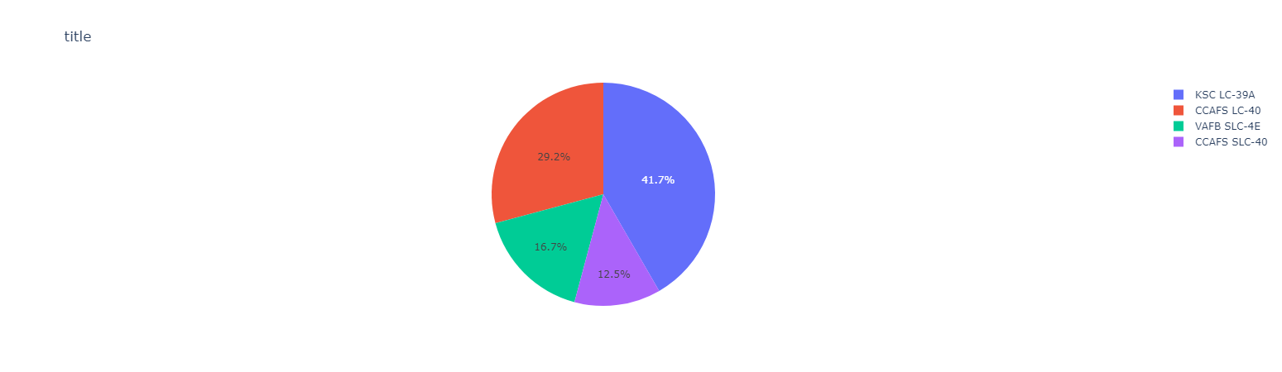
Build a Dashboard with Plotly Dash
We built an interactive dashboard with Plotly dash
We plotted pie charts showing the total launches by a certain sites
We plotted scatter graph showing the relationship with Outcome and Payload Mass (Kg) for the different booster version.
Add the GitHub URL of your completed Plotly Dash lab, as an external reference and peer-review purpose
The link to the code base: https://github.com/Giga1025/IBM_Data_Science_capstone/blob/main/Data_visualization_dash.ipynb

Slide 15
Predictive Analysis (Classification)
Charts
Create NumPy array from the Class column
Standardize the data with StandardScaler. Fit and transform the data.
Split the data using train_test_split
Create a GridSearchCV object with cv=10 for parameter optimization
Apply GridSearchCV on different algorithms: logistic regression (LogisticRegression()), support vector machine (SVC()), decision tree (DecisionTreeClassifier()), K-Nearest Neighbor (KNeighborsClassifier())
Calculate accuracy on the test data using .score() for all models
Assess the confusion matrix for all models
Identify the best model using Jaccard_Score, F1_Score and Accuracy
The link to the code base: https://github.com/Giga1025/IBM_Data_Science_capstone/blob/main/Data_prediction_analysis.ipynb

Slide 16
Results
Exploratory Data Analysis
Launch success has improved over time
KSC LC-39A has the highest success rate among landing sites
Orbits ES-L1, GEO, HEO and SSO have a 100% success rate Results Summary
Visual Analytics
Most launch sites are near the equator, and all are close to the coast
Launch sites are far enough away from anything a failed launch can damage (city, highway, railway), while still close enough to bring people and material to support launch activities
Predictive Analytics
Decision Tree model is the best predictive model for the dataset

Slide 17

Section 2

Slide 18
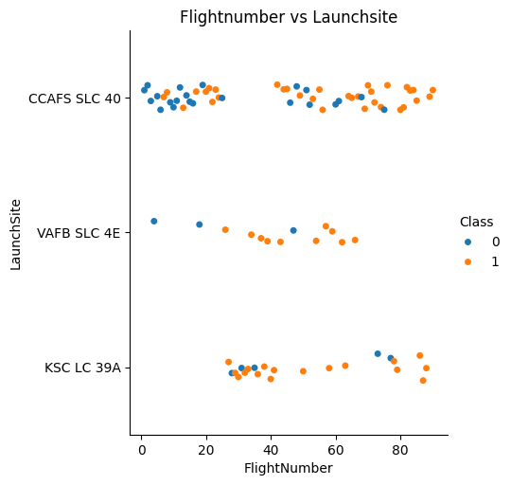
Flight Number vs. Launch Site
Exploratory Data Analysis
Earlier flights had a lower success rate (blue = fail)
Later flights had a higher success rate (orange = success)
Around half of launches were from CCAFS SLC 40 launch site
VAFB SLC 4E and KSC LC 39A have higher success rates
We can infer that new launches have a higher success rate

Slide 19
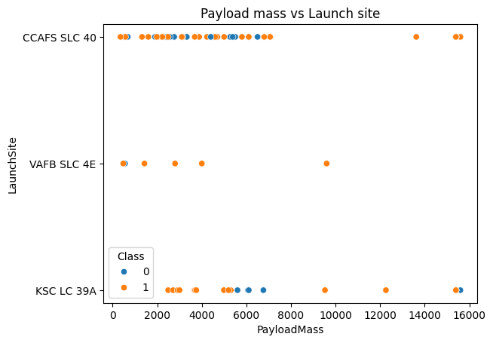
Payload vs. Launch Site
Exploratory Data Analysis
Typically, the higher the payload mass (kg), the higher the success rate
Most launces with a payload greater than 7,000 kg were successful
KSC LC 39A has a 100% success rate for launches less than 5,500 kg
VAFB SKC 4E has not launched anything greater than ~10,000 kg

Slide 20
Success Rate vs. Orbit Type
Exploratory Data Analysis
100% Success Rate: ES-L1, GEO, HEO and SSO
50%-80% Success Rate: GTO, ISS, LEO, MEO, PO
0% Success Rate: SO

Slide 21
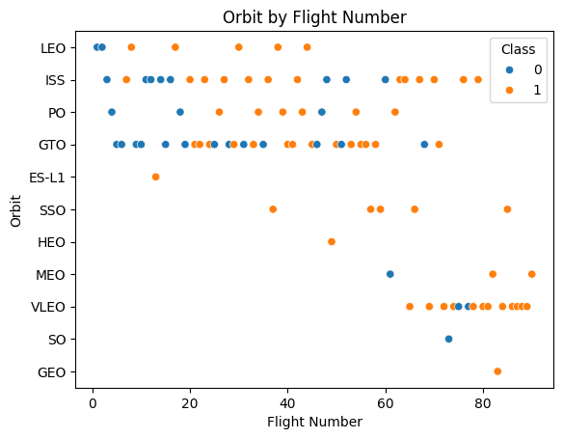
Flight Number vs. Orbit Type
Exploratory Data Analysis
The success rate typically increases with the number of flights for each orbit
This relationship is highly apparent for the LEO orbit
The GTO orbit, however, does not follow this trend

Slide 22
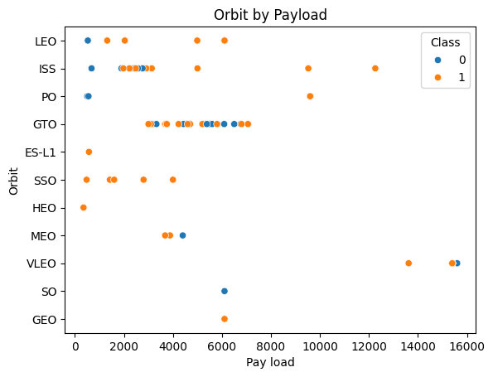
Payload vs. Orbit Type
Exploratory Data Analysis
Heavy payloads are better with LEO, ISS and PO orbits
The GTO orbit has mixed success with heavier payloads

Slide 23
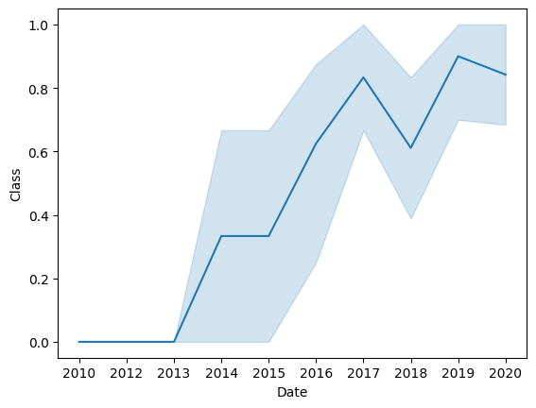
Launch Success Yearly Trend
Exploratory Data Analysis
The success rate improved from 2013-2017 and 2018-2019
The success rate decreased from 2017-2018 and from 2019-2020
Overall, the success rate has improved since 2013

Slide 24

All Launch Site Names
Launch Site Names
CCAFS LC-40
CCAFS SLC-40
KSC LC-39A
VAFB SLC-4E

Slide 25

Launch Site Names Begin with 'CCA'
Records with Launch Site Starting with CCA
Displaying 5 records below

Slide 26

Total Payload Mass
The total payload mass for all the missions carried out till now 45,596 kg (total) carried by boosters launched by NASA (CRS)

Slide 27

Average Payload Mass by F9 v1.1
The average payload mass carried by booster version F9 v1.1 as 2928.4

Slide 28

First Successful Ground Landing Date
The date of the first successful landing outcome on ground pad was observed to be on 22nd December 2015

Slide 29
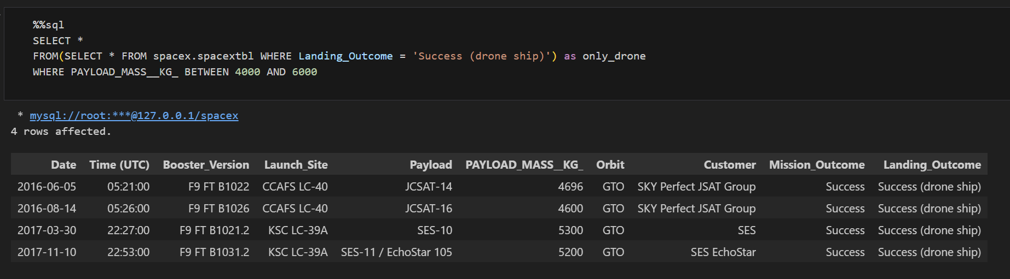
Successful Drone Ship Landing with Payload between 4000 and 6000
Booster Drone Ship Landing
Booster mass greater than 4,000 but less than 6,000
JSCAT-14, JSCAT-16, SES-10, SES-11 / EchoStar 105

Slide 30
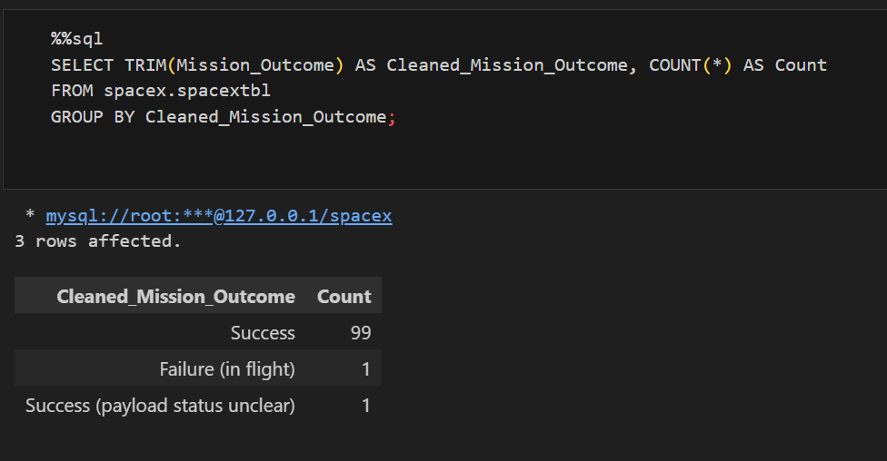
Total Number of Successful and Failure Mission Outcomes
The outcomes of the missions

Slide 31

Boosters Carried Maximum Payload
We determined the booster that have carried the maximum payload using a subquery in the WHERE clause and the MAX() function.

Slide 32

2015 Launch Records
In 2015
Showing month, date, booster version, launch site and landing outcome

Slide 33

Rank Landing Outcomes Between 2010-06-04 and 2017-03-20
Ranked Descending
Count of landing outcomes between 2010-06-04 and 2017-03-20 in descending order

Slide 34

Section 3

Slide 35

Launch Sites
With Markers
Near Equator: the closer the launch site to the equator, the easier it is to launch to equatorial orbit, and the more help you get from Earth's rotation for a prograde orbit. Rockets launched from sites near the equator get an additional natural boost - due to the rotational speed of earth - that helps save the cost of putting in extra fuel and boosters.

Slide 36

Launch Outcomes
Launch Outcomes At Each Launch Site
Outcomes:
Green markers for successful launches
Red markers for unsuccessful launches
Launch site CCAFS SLC-40 has a 3/7
success rate (42.9%)

Slide 37

Distance to proximities
Replace <Folium map screenshot 3> title with an appropriate title
Explore the generated folium map and show the screenshot of a selected launch site to its proximities such as railway, highway, coastline, with distance calculated and displayed
Explain the important elements and findings on the screenshot

Slide 38

Section 4

Slide 39

Launch Success By Site
Success as Percent of Total
KSC LC-39A has the most successful launches amongst launch sites (41.2%)

Slide 40

Launch Success (KSC LC-29A)
Success as Percent of Total
KSC LC-39A has the highest success rate amongst launch sites (76.9%)
10 successful launches and 3 failed launches

Slide 41

Payload mass and success
By Booster Version
Payloads between 2,000 kg and 5,000 kg have the highest success rate
1 indicating successful outcome and 0 indicating an unsuccessful outcome

Slide 42

Section 5

Slide 43
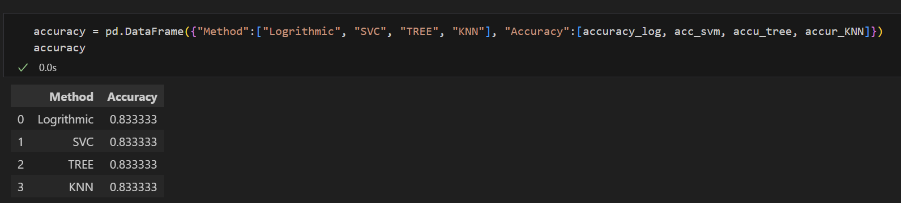
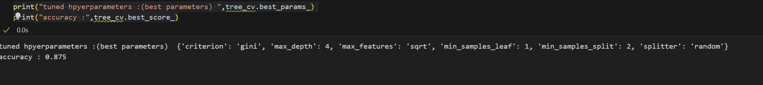
Classification Accuracy
Accuracy
All the models performed at about the same level and had the same scores and accuracy. This is likely due to the small dataset. The Decision Tree model slightly outperformed the rest when it came to the best_score

Slide 44

Confusion Matrix
The confusion matrix for the decision tree classifier shows that the classifier can distinguish between the different classes. The major problem is the false positives .i.e., unsuccessful landing marked as successful landing by the classifier.

Slide 45
Conclusions
Research
Model Performance: The models performed similarly on the test set with the decision tree model slightly outperforming
Equator: Most of the launch sites are near the equator for an additional natural boost - due to the rotational speed of earth - which helps save the cost of putting in extra fuel and boosters •
Coast: All the launch sites are close to the coast
Launch Success: Increases over time
KSC LC-39A: Has the highest success rate among launch sites. Has a 100% success rate for launches less than 5,500 kg
Orbits: ES-L1, GEO, HEO, and SSO have a 100% success rate
Payload Mass: Across all launch sites, the higher the payload mass (kg), the higher the success rate

Slide 46


